Slide 1

Project Presentation on E -Learning Management System
Presenters
Nikitha Rao Jakati
Sivani Akkem
Haritha Talupula
Umarani Vemula
Jyothirmayee Manne
Sai Rukma Reddy Gade
Lakshmi Dheeraj Oruganti
Sai Krupananda Reddy Bakaram

Slide 2
Introduction
The term "e-learning" is used to describe the process of receiving any form of education through the use of a computer, regardless of whether or not the machine in question is linked to the World Wide Web.
The process of obtaining new information through the use of digital platforms is referred to as "e-learning."
The term "e-learning" refers to any and all forms of education that involve the utilization of electronic media and the Internet.
The information and communication technologies that are used to impart instruction are the types of media that are employed.

Slide 3
System Requirements
Atleast Contains a web browser Any contemporary web browser, such as Google Chrome or Mozilla Firefox, for example (2020 versions & later)
Operating System: Operating Systems: Windows, Ubuntu, MacOS, and Linux OS
Internet connection capable of high speeds

Slide 4
Functional Requirements
A homepage that not only introduces new users to the site but also guides them to further sections.
All data tables were implimented\sAccount registration and Login for both Teacher and Student.
Students able to join a classroom, A course etc/.
A Student is able to access both his own profile as well as the dashboard for the class he is now attending.
A student is able to download assignments, delete assignments, update assignments, and modify assignments.
A instructor has the ability to examine the profiles of any and all students who have enrolled in his Class.
Teacher can be able to build a classroom, A course etc/.
A teacher is able to access both his own profile as well as the dashboard for the class he is now coaching.
A teacher is able to add assignments, delete assignments, update assignments, and modify assignments.

Slide 5
Non-Functional Requirements
It is possible to load pages rapidly and without difficulty in real time.
An intuitive and pleasurable user interface and user experience (UI/UX) that streamlines the processes that the customer goes through when making use of the product.
When stored on systems, information that pertains to students as well as faculty members is required to have complete and total confidentiality at all times.
System software for mobile devices as well as that for desktop computers and any other type of operating system should be compatible.
At Your Complete Disposal At All Times It is expected that the system will continue to function normally 24 hours a day, seven days a week, regardless of whether or not maintenance is being performed.
There will be content that can be interacted with posted.

Slide 6
User Requirements
A student should be able to sign up or sing in (for his or her account) using this feature.
It should make it possible for the instructor to submit announcements and assignments.
It should make it possible for students to hand in their assignments.
A professor should be able to submit online Random Assessment Tests using this functionality. In the event that the questions were multiple choice, it should have scored the papers and saved the scores for each individual student.
It ought to make it possible for lecturers to publish stuff.
Students should be able to share their thoughts on the website.
It should make it possible for a lecturer to submit answers to difficult CAT or RAT problems.

Slide 7
UML Design
Class Diagram
Use case Diagram
Sequence Diagram

Slide 8
ER/Class Diagram
There is consensus among industry experts that the ER model is the best example of a conceptual data model at the enterprise level.
The ER (Entity Relationship) Diagram that has been presented here illustrates the idea of an E-Learning Management System Entity.

Slide 9
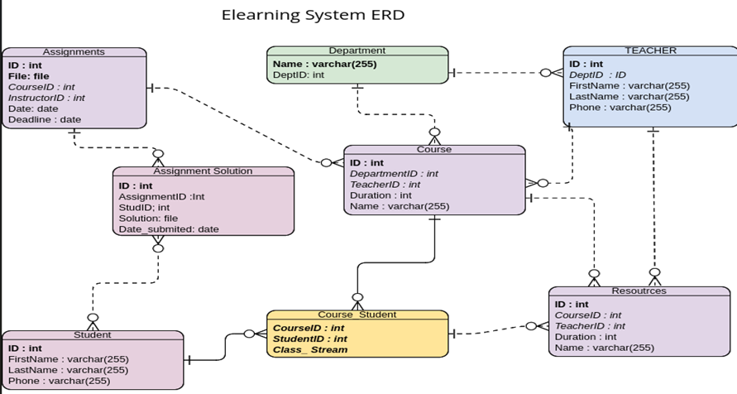
E-Learning System ERD

Slide 10
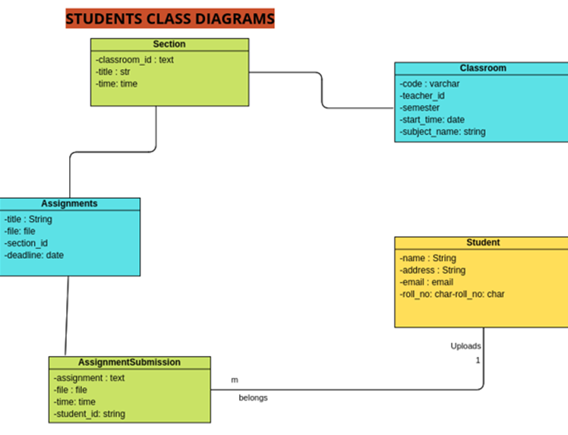
STUDENTS CLASS DIAGRAM

Slide 11
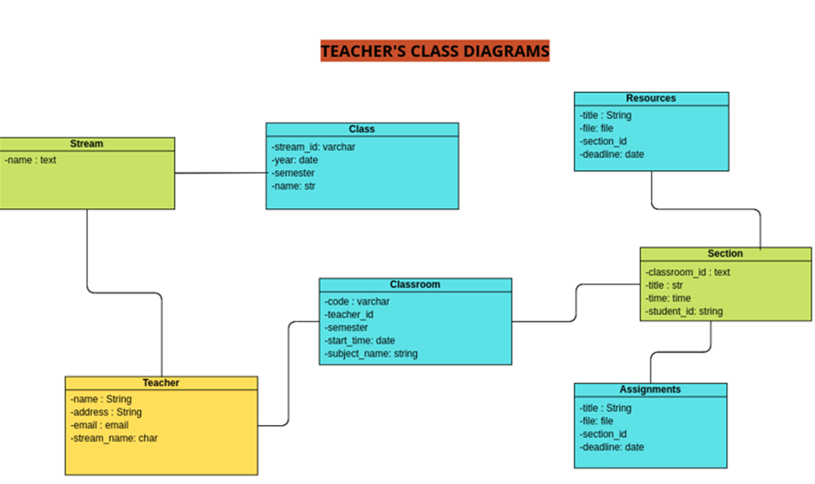
Class Diagram for teacher

Slide 12
Sequence Diagram
This is an example of a UML sequence diagram for an e-learning management system. It demonstrates how the objects of Student, teacher interact with system.
The diagram may be seen by both students and instructors.
The following is a rundown of the chronological order on how the student and teacher action from enrolling to a class, selecting resources and checking asssignments.
It demonstrates how the objects of AccountLogout, AddCourse, Login, ResourcesAdd, ResourcesDownload, and Signup interact with one another. The diagram may be seen by both students and instructors.
The following is a rundown of the chronological order of each action:

Slide 13
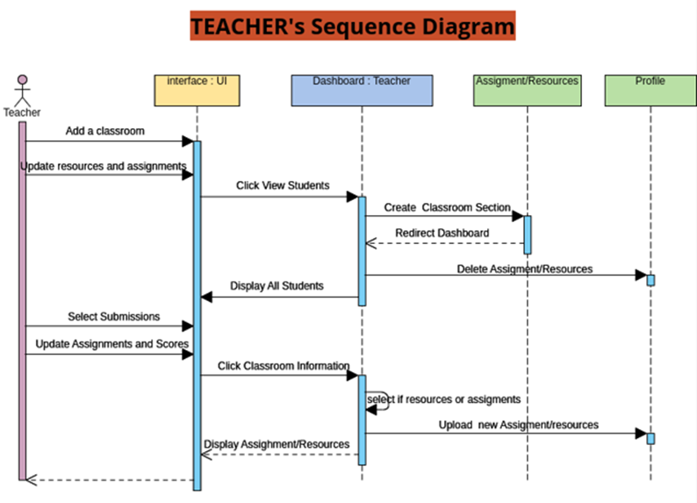
Teacher Sequence Diagram

Slide 14
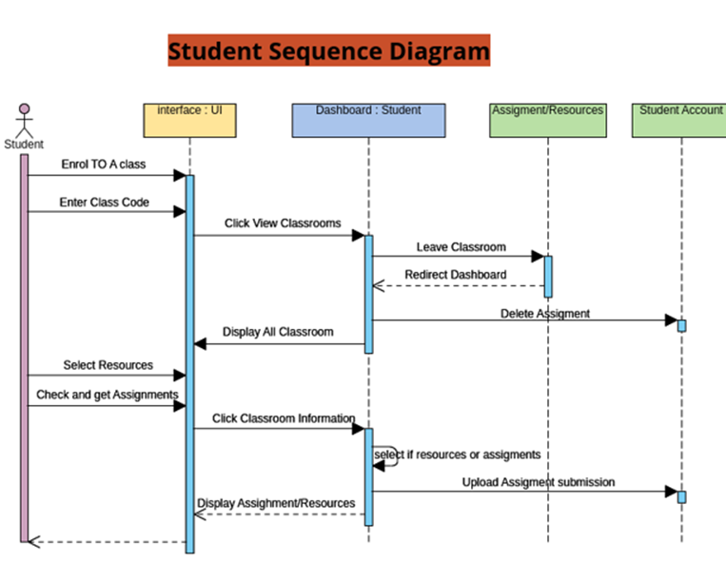
Sequence Diagram for Student

Slide 15
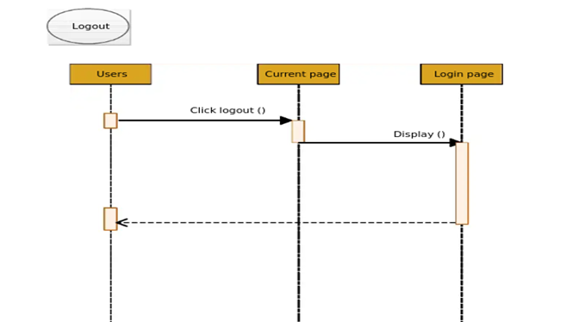
AccountLogout

Slide 16
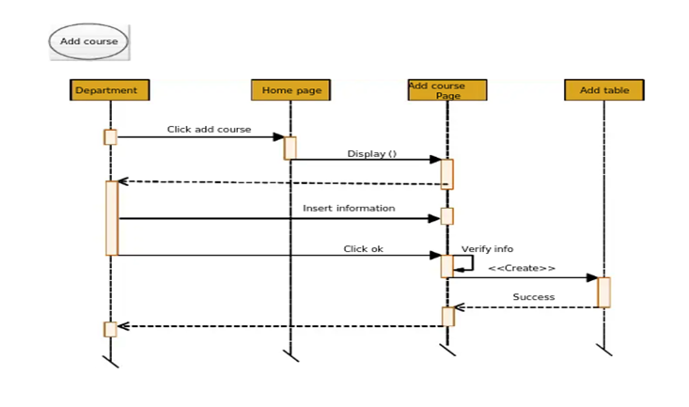
Add course

Slide 17
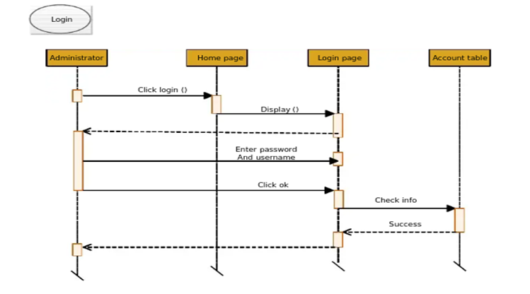
Login

Slide 18
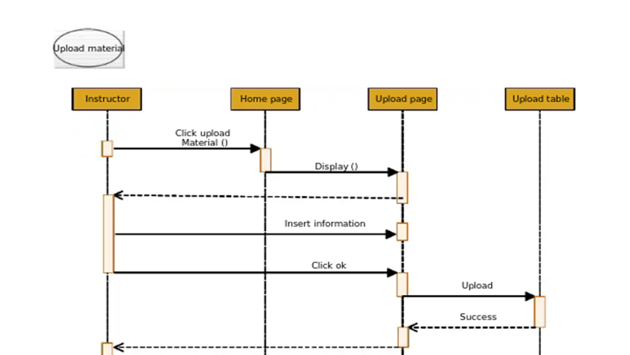
ResourcesAdd

Slide 19
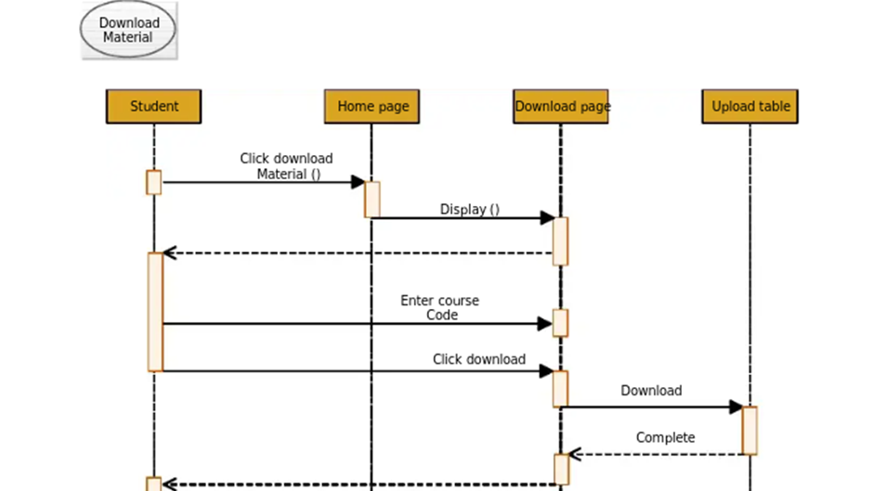
ResourcesDownload

Slide 20
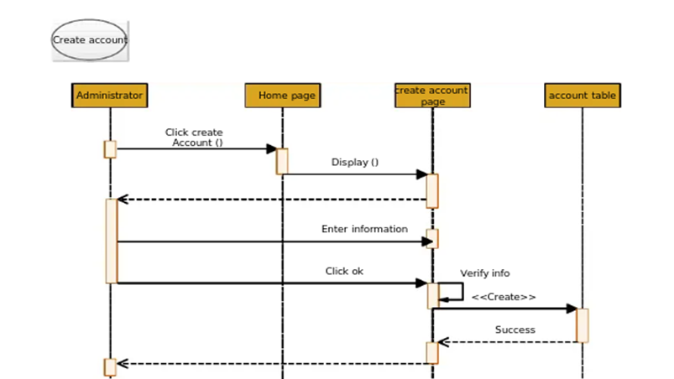
SignUp

Slide 21
Use case Model
An e-learning management system's use case diagrams are graphical representations of the relationships between the many modules that make up the system.
Using a process that is quite similar to the one represented up above, the system demands of an e-learning content management system may be uncovered, clarified, and structured.
Some of these use cases include: viewing homepage details, viewing classroom codes, enrolling to a class, uploading assignment, viewing, downloading resources and assignment, deleting and modifying assignment, managing the subject, leaving the classroom and managing the full e-learning management system operations.

Slide 22
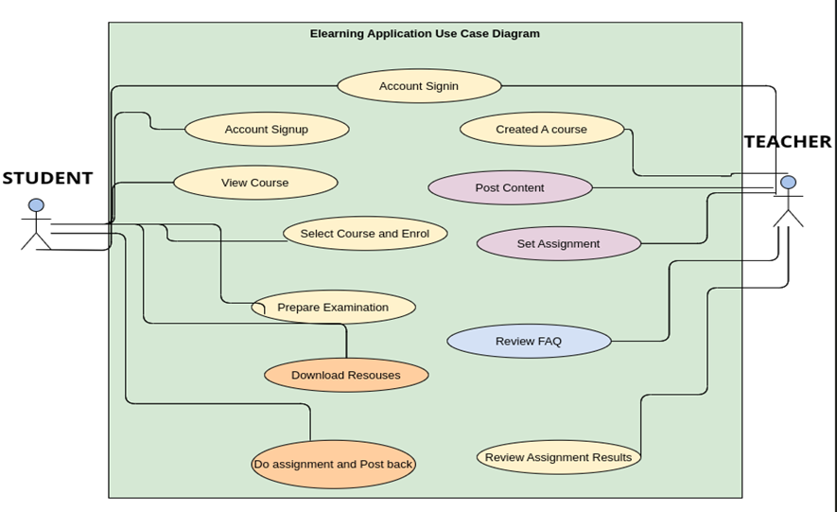
E-learning system Use Case Diagram

Slide 23
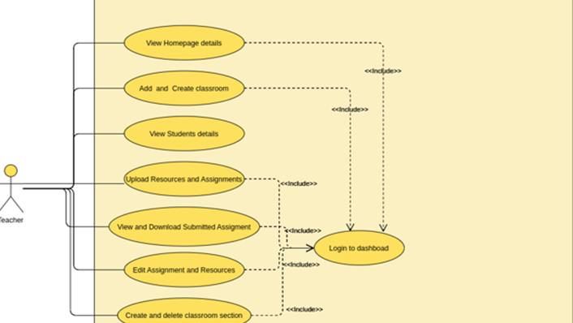
Use case model for teacher

Slide 24
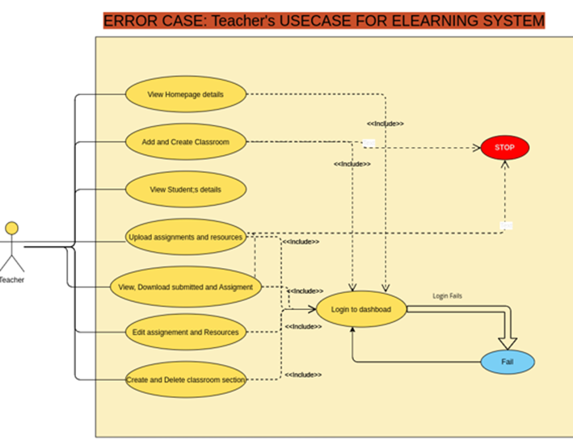
Error case: Teacher’s Use case for eLearning system

Slide 25
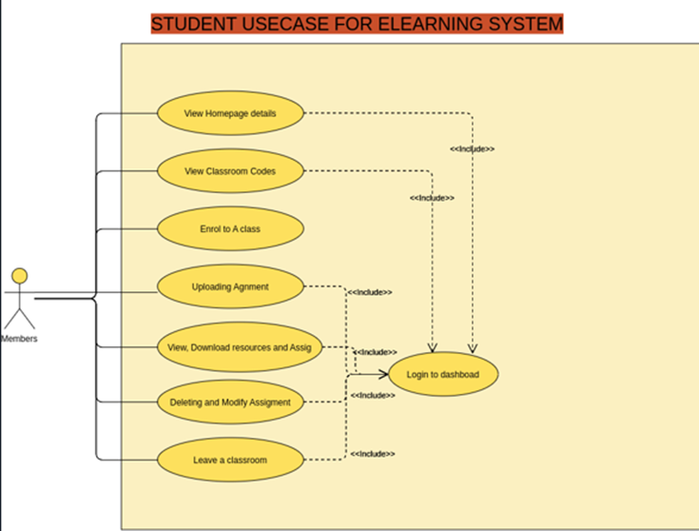
Student use case Diagram for eLearning System

Slide 26
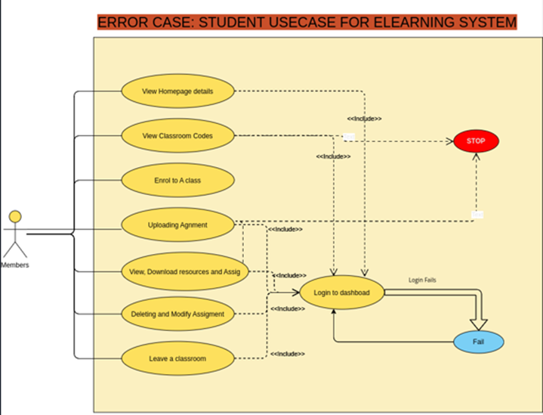
Student UML Error case

Slide 27

Test cases
Test cases include:
Student login/signup: The student should be able to login and signup.
Leave a classroom: Student should be able to leave the classroom.
Upload assignment: Student should be able o upload assignments.
Download resources and assignment: Student can download resources and assignments without any trouble.
Delete and update assignment: Student can delete and update assignments.
Join a classroom: student can join a classroom.
View all classroom: Student can view all available classroom.
Access students' dashboard upon login: Student can access the dashboard while the student log in.

Slide 28
Limitations
Technological Limitations: The availability of enough resources and computing gear is one of the most significant technological constraints in e-learning. The necessity for students to have constant access to desktops or laptops, as well as the expense of hardware, is seen as the primary barrier of this sort of learning systems and is the primary reason why small and medium level firms do not take the risk of E-learning to educate their personnel.
Personal limitations: Learners who are unfamiliar with e-learning need to be prepared for the reality that, contrary to popular belief, e-learning is not the same as conventional learning. In the absence of direct instruction, even inexperienced students may be tempted to abandon e-learning.

Slide 29
User manual
To run this application, do the following:
Make sure you have installed python3.8 or higher
Install pip3
After installing the above, run the following command.
`pip -r requirements.txt && python manage.py makemigrations $$ python manage.py migrate && python manage.py runserver`
- The above is a 4 commands line which you can split into individuals if you want so.

Slide 30
Conclusion
In conclusion, I've realized that developing a completely working system is not only challenging labor, but it also requires an in-depth knowledge of database architecture and several programming languages.
This was one of the most valuable lessons I've ever acquired. While carrying out this research, we discovered something that led us to this conclusion.

Slide 31
Work Cited
Ülker, D., & Yılmaz, Y. (2016). Learning Management Systems and Comparison of Open Source Learning Management Systems and Proprietary Learning Management Systems. Journal Of Systems Integration, 18-24. https://doi.org/10.20470/jsi.v7i2.255
WARSCHAUER, M. (1997). Computer-Mediated Collaborative Learning: Theory and Practice. The Modern Language Journal, 81(4), 470-481. https://doi.org/10.1111/j.1540-4781.1997.tb05514.x
Syed, T. A., Palade, V., Iqbal, R., & Nair, S. S. (2017). A personalized learning recommendation system architecture for Learning Management System. Proceedings of the 9th International Joint Conference on Knowledge Discovery, Knowledge Engineering and Knowledge Management. https://doi.org/10.5220/0006513202750282

Slide 32

THANK YOU!!!

